Slide 1
Behavior Modeling
Introduction to Game Design and Development
ITCS 4230/5230
Dr. Dewan Tanvir Ahmed
Department of Computer Science
University of North Carolina at Charlotte

Slide 2
Outline
Behaviour Modeling
Finite State Machine (FSM)
Hierarchical FSM
Non-deterministic Hierarchical FSM
Subsumption Architecture
Expert Systems
Influence Map
Reputation System

Slide 3
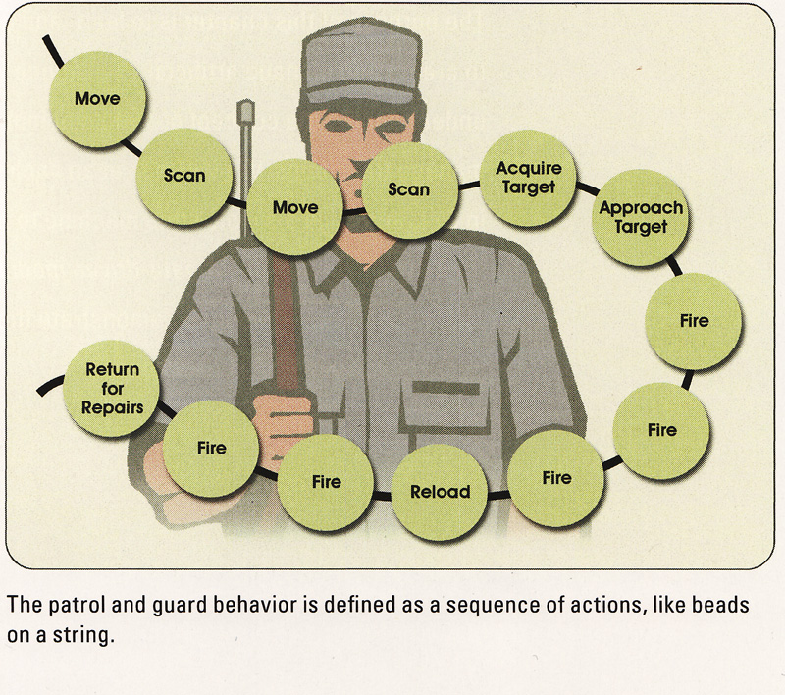
Behaviour
AI model for behavior
Behavior is defined as a sequence of actions - one after another.

Slide 4
Dynamic Sequences
AI behaviours can/should vary depending on circumstances
Example:
Guard behaviour
Can fire three times
Enemy is destroyed after five shots
Enemy can damage the agent
Weaker enemy may require different sequence
EX. Enemy is destroyed after two shots

Slide 5
State Machine Models
State machine models show
System states as nodes and events as arcs between these nodes.
Model the behaviour of the system in response to
external and internal events
Show the system’s responses to stimuli
often used for modelling real-time systems

Slide 6
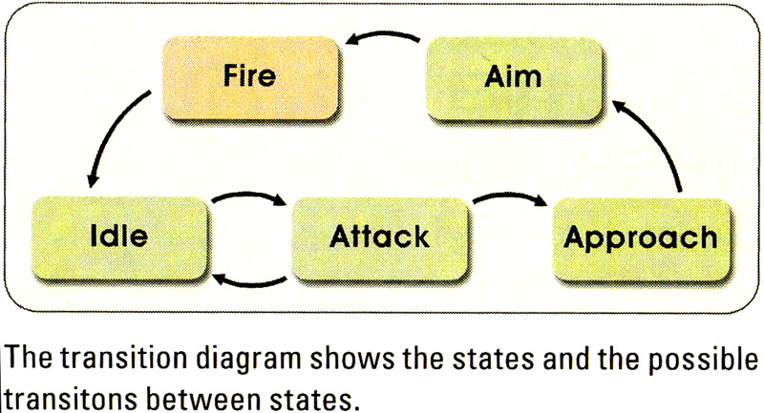
Finite State Machine
FSM is a commonly used system in video games for modeling AI for dynamic behavior
Guard states

Slide 7
State Transitions
Internal
Timer, energy level, etc.
External
Usually user input
Deferred
Executed next time (collectively)
Immediate
Executed immediately

Slide 8
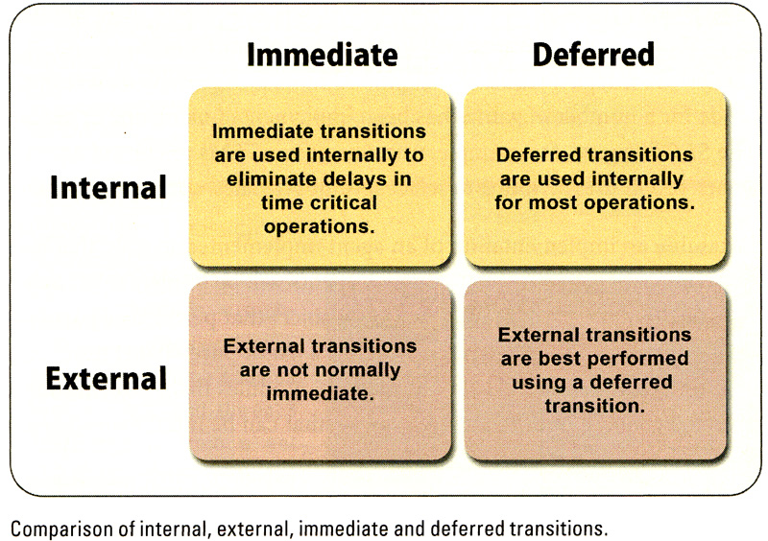
Transitions

Slide 9
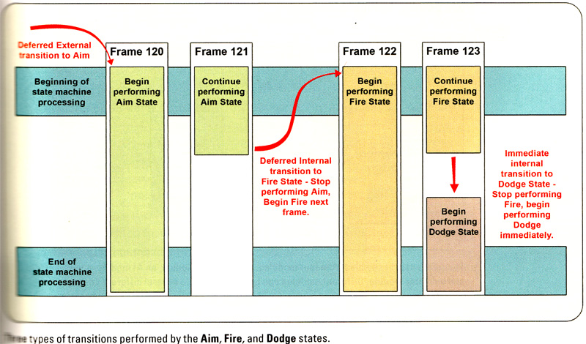
Example

Slide 10
AI Controlled by FSM
AI Agent
Body module
Movement module
Behavior control
Display module
Modular design is used in many engines
e.g Unreal
can be mixed with data-driven method

Slide 11
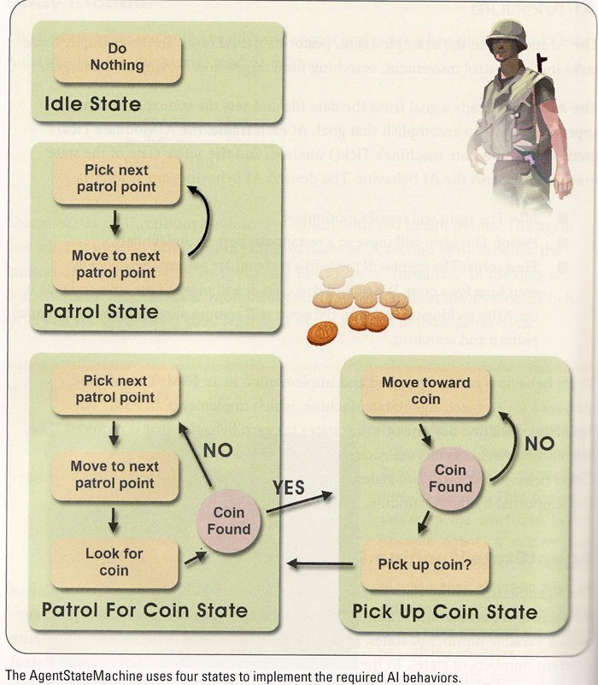
AI Module
Patrol searching for a target
Idle
Patrol
Find coins

Slide 12
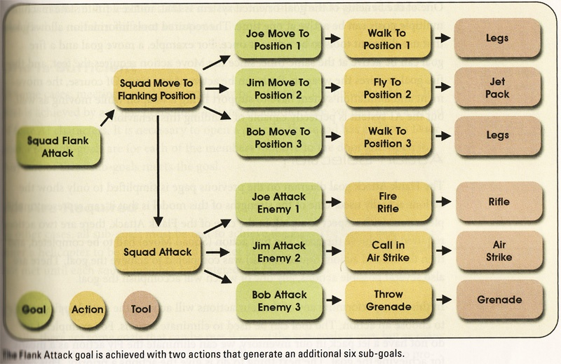
Goal-oriented AI Model

Slide 13
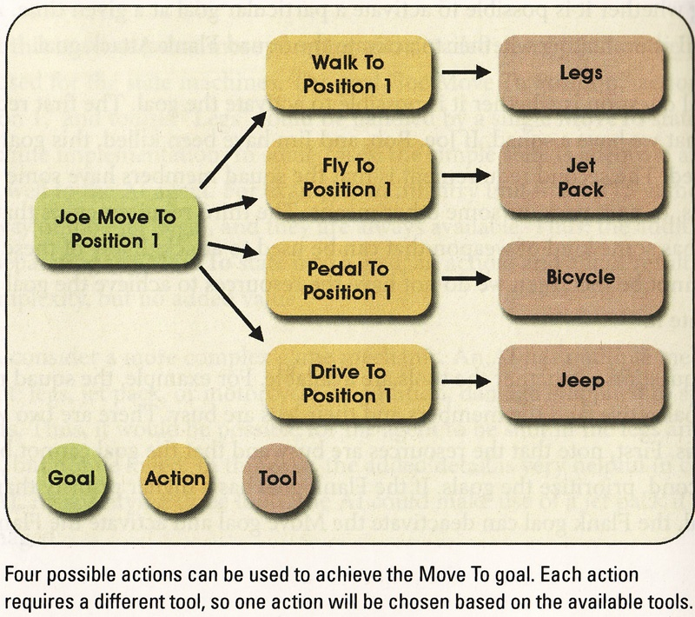
Action Selection

Slide 14
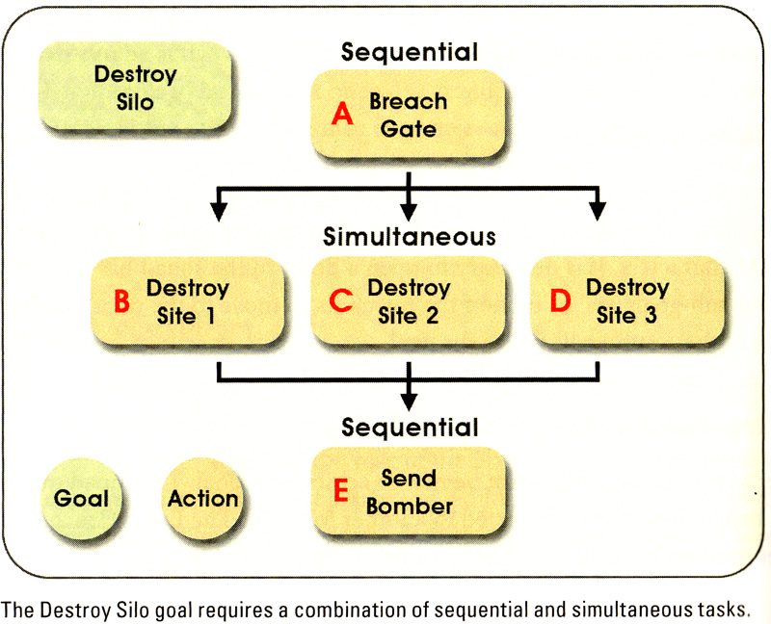
Multiple Actions

Slide 15
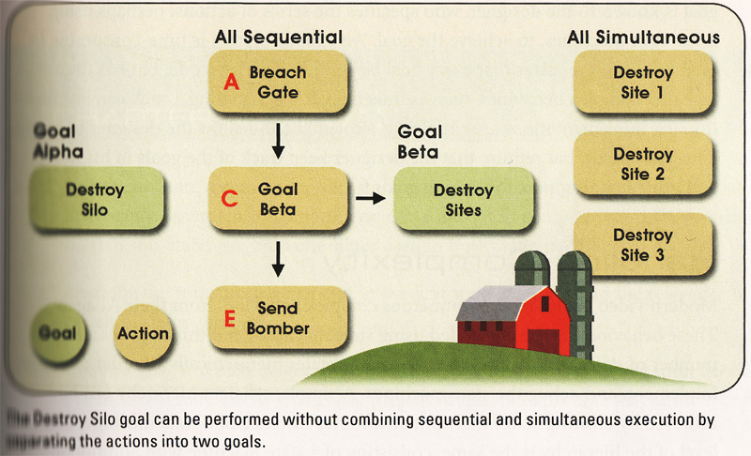
Multiple Actions

Slide 16
Hierarchical FSMs
Expand a state into its own sub-FSM
Transition
Some events move you around the same level in the hierarchy
some move you up a level
When entering a state
have to choose a state for it’s child in the hierarchy
Set a default
Random choice
Usually depends on the nature of behavior

Slide 17
Hierarchical FSM Example
Attack
Wander
~E
Pick-up
Powerup
E
Chase
~S
S
Start
Spawn
Turn Right
D
~E
Go-through
Door
E = Enemy
S = See
D = Dead

Slide 18
Non-Deterministic Hierarchical FSM (Markov Model)
Adds variety to actions
Have multiple transitions for the same event
Label each with a probability that it will be taken
Randomly choose a transition at run-time
Markov Model: New state only depends on the previous state
Aim &
& Shoot
& miss
Attack
.1
Approach
.2
Aim &
Slide Right
& Shoot
.3
Start
.4
Aim &
Slide Left
& Shoot
Aim &
Jump &
Shoot

Slide 19
Stack-Based State Machine
Also referred to as push-down automata
Remembers past states
Allows for diversions, later returning to previous behaviors
Stack allows AI to move back and forth between states.
Leads to more realistic behavior without increasing FSM complexity.

Slide 20
Subsumption Architecture
Popularized by the work of Rodney Brooks
Separates behaviors into concurrently running finite-state machines
Lower layers
Rudimentary behaviors (like obstacle avoidance)
Higher layers
Goal determination and goal seeking
Lower layers have priority
System stays robust

Slide 21
Expert Systems
Expert systems (or rule-based systems)
Set of behavioural rules
Selected by an “expert”
Suitable when there is no clear algorithm to solve a problem
Three components
Knowledge base
Working memory
Inference engine

Slide 22
Expert Systems - Knowledge Base
A series of rules
Rule 1: IF condition THEN action
Rule 2: IF condition THEN action
….
Rule n: IF condition THEN action

Slide 23
Expert Systems - Working Memory
Set of known facts (game data)
Red light is on.
Energy level is low.
Caution is required.

Slide 24
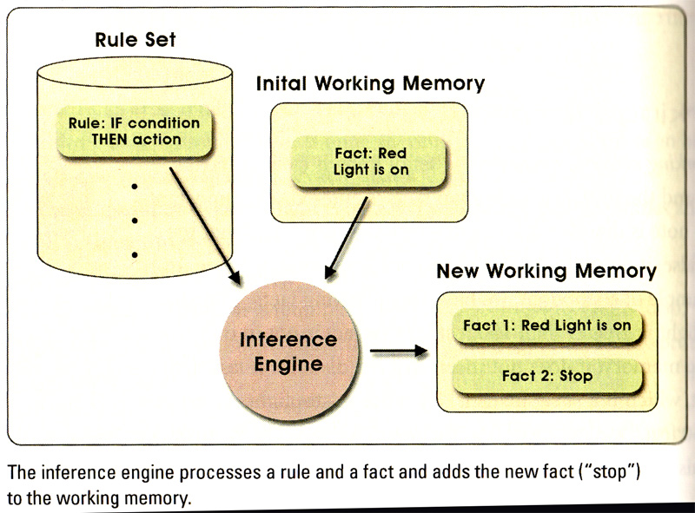
Expert Systems - Inference Engine

Slide 25
Expert Systems - Challenges
Conflicting information
Different rules
Inconsistent results
IF pedestrian in walkway THEN stop
IF green-light THEN go
Conflict resolution
Remove conflicting facts
Prevent the addition of conflicting facts
IF green AND no-stop THEN go
Add priority

Slide 26
Expert Systems - Forward Chaining
FACT: red light is flashing
RULE: IF red flashing THEN caution
NEW FACT: caution required
FACT: vehicle is moving
RULE: IF caution AND moving THEN stop
NEW FACT: stopping

Slide 27
Level-of-Detail AI
Optimization technique like graphical LOD
Only perform AI computations if player will notice
For example
Only compute detailed paths for visible agents
Off-screen agents don’t think as often

Slide 28
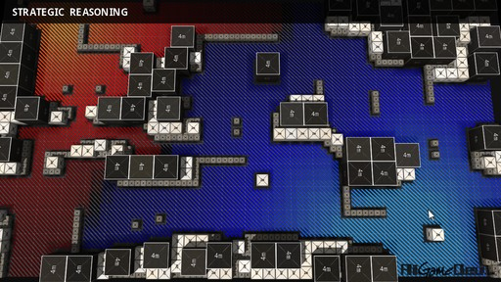
Influence Mapping
Method for viewing/abstracting distribution of power within game world
Typically 2D grid superimposed on land
Unit influence is summed into each grid cell
Unit influences neighboring cells with falloff
Facilitates decisions
Can identify the “front” of the battle
Can identify unguarded areas
Article to read
Image source: aigamedev.com

Slide 29
Influence Mapping - Motivation
Situation Summary —
Summarizing all the little details of the world
Easy to understand at a glance.
Who's in control of what area? Where are the borders between the territories? How much enemy presence is there in each area?
Historical Statistics —
remember what happened for a certain period of time.
Was this area being assaulted?
How well did my previous attack go?
Future Predictions —
help predict the future - using the map of the terrain

Slide 30
Reputation System
Models player’s reputation within game world
Agents learn new facts by watching player or from gossip from other agents
Based on what an agent knows
Might be friendly toward player
Might be hostile toward player
Affords new gameplay opportunities
“Play nice OR make sure there are no witnesses”

Slide 31
References
Game Artificial Intelligence
John B. Ahlquist and Jeannie Novak
Thomson, 2008
AI Game Engine Programming
Brian Schwab
Charles River Media, 2004
Some slides are taken from the different online sources. I acknowledge them.

Slide 32
Thank you!

